Slide 1
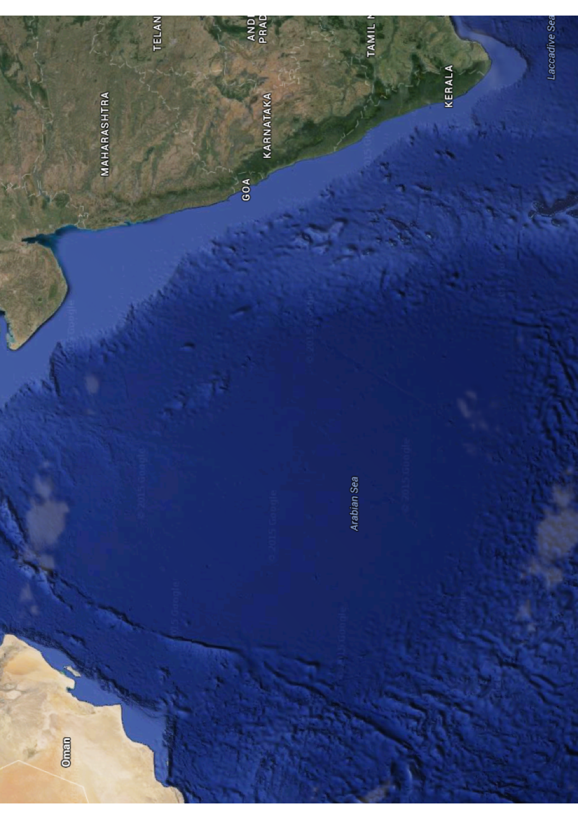
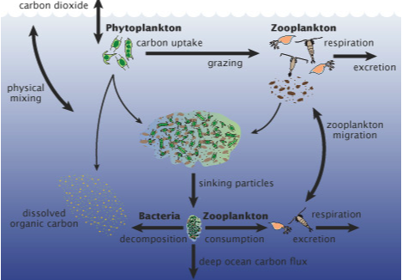
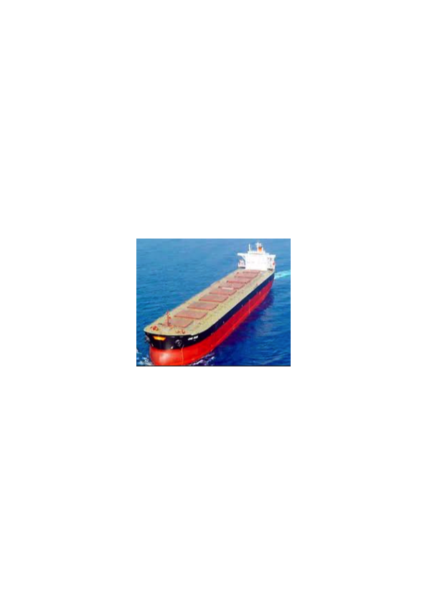
SEQUENCE OF BUOYANT FLAKE OCEAN
FERTILIZATION TRIALS
Oman
Marine cloud albedo increases
1st Experiment = 7Ha of buoyant flakes disseminated
India
Ocean albedo increases
DMS emissions nucleate clouds
Arabian Sea
* National Institute of Oceanography (NIO)
2nd = 50 Ha, a fortnight later
Reversing Current
3rd = 350 Ha
4th = 25 km²
Fertilization develops a rich, stable ecology
5th = 170 km²
Bulk tankers spray flakes downwind
* Minicoy Island
6th = 1,200 km²

